Slide 1

City of boston: City Budget & Bus routes
summer 2024
Julissa Mijares and Tauriel Duan
PM: Wentao Chen

Slide 2
City Budget
‹#›

Slide 3
Base Questions
1
Spending by Department
2
Spending by Budget Category
3
Spending by Geography
4
Spending by Program

Slide 4
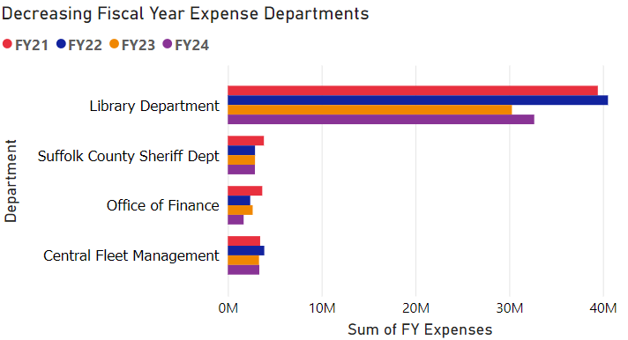
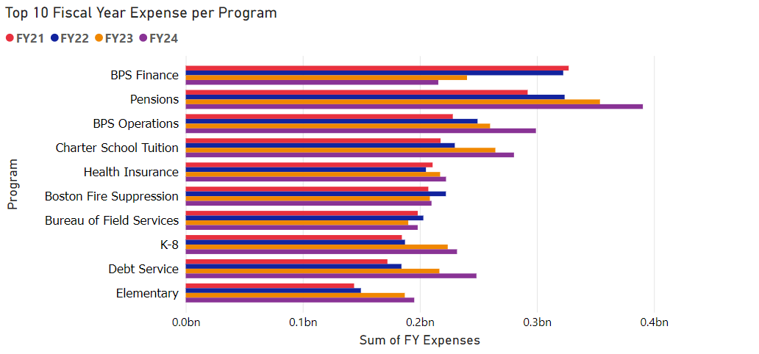
Prior Insights
Increase for the Execution of Courts (136.81%) and Annual Audit Cost (133.88%)
Decrease for the Office of Finance (20.12%) and Suffolk County Sheriff Department (8.32%)
Focus of areas such as education, safety, and health.

Slide 5
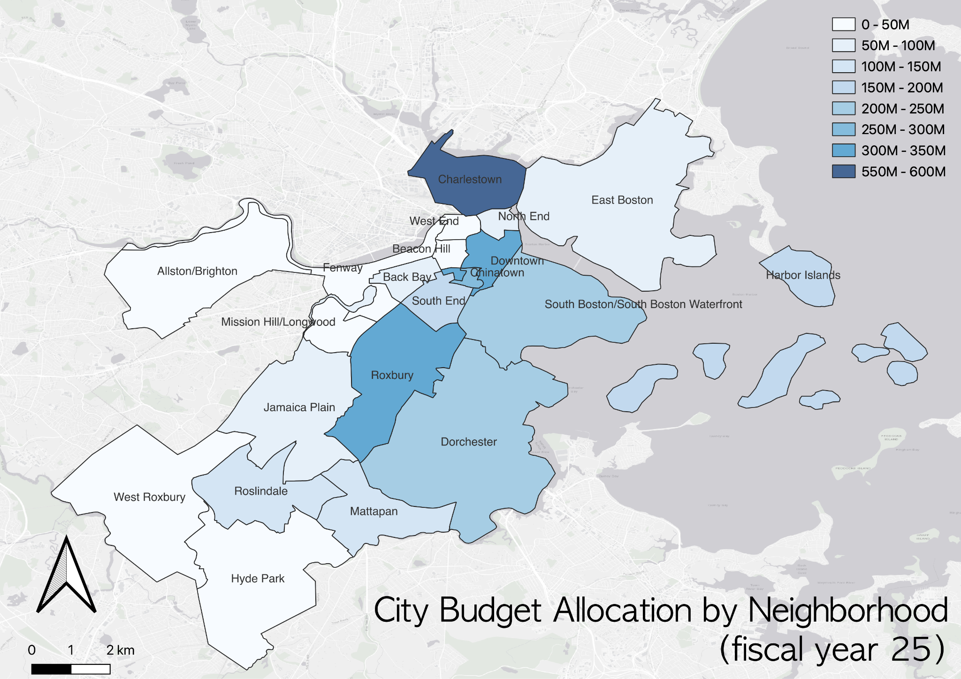
Spending by Geography
Total Budget：
Top 3: 1. Charlestown: $599.4M (19.8%)
2. Downtown: $318.2M (10.8%)
3. Roxbury: 313.8M (10.4%)
Lowest 3:
1. Mission Hill/Longwood: $0.55M (0.18%)
2. Hyde Park: $0.75M (0.25%)
3. West End: $2.4M (0.79%)

Slide 6
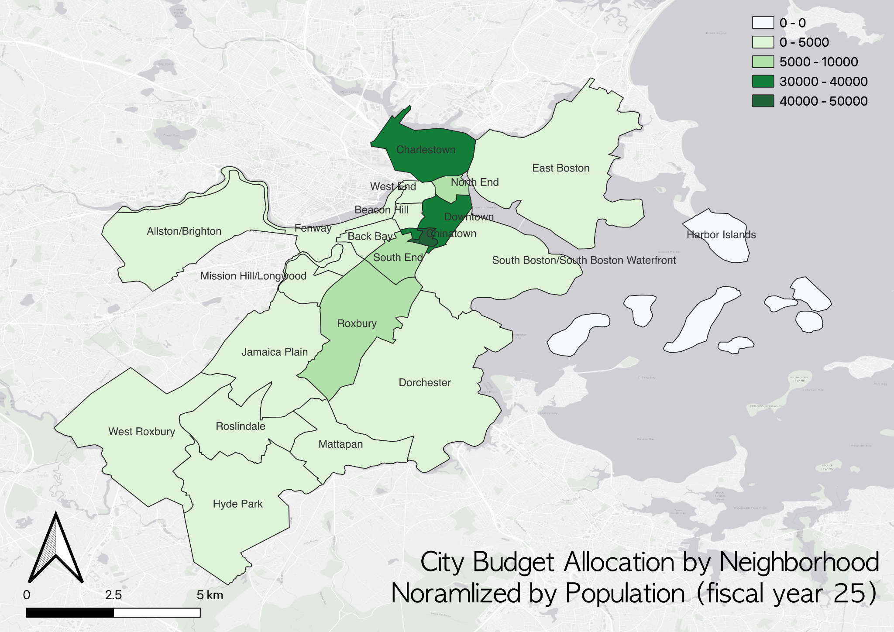
Spending by Geography
Normalized by census(Harbor island has no census data, excluded)
Top 3:
1. Chinatown: $47488 per person
2. Downtown: $35203 per person
3. Charlestown: $31529 per person
Lowest 3:
1. Hyde Park: $222 per person
2. Mission Hill: $339 per person
3. Allston/Brighton: $671 per person

Slide 7
cONCLUSION
Diverse Array of Program Spending, with a focus on areas such as education, safety, and health.
For FY2025, Michelle Wu plans for an 8% increase over the overall budget, with 56% allocated to education and public safety.
Charlestown, Downtown and Roxbury have the top 3 budget overall
Chinatown, Downtown and Charlestown become the top 3 after normalized by census

Slide 8
Bus routes
‹#›

Slide 9
Base Questions
What are the end-to-end travel times for different bus routes?
1
2
Are there disparities in the service levels of different routes?
What are the population sizes and characteristics of the communities serviced by different bus routes?
3
If there are service level disparities, are there differences in the characteristics of the people most impacted?
4

Slide 10
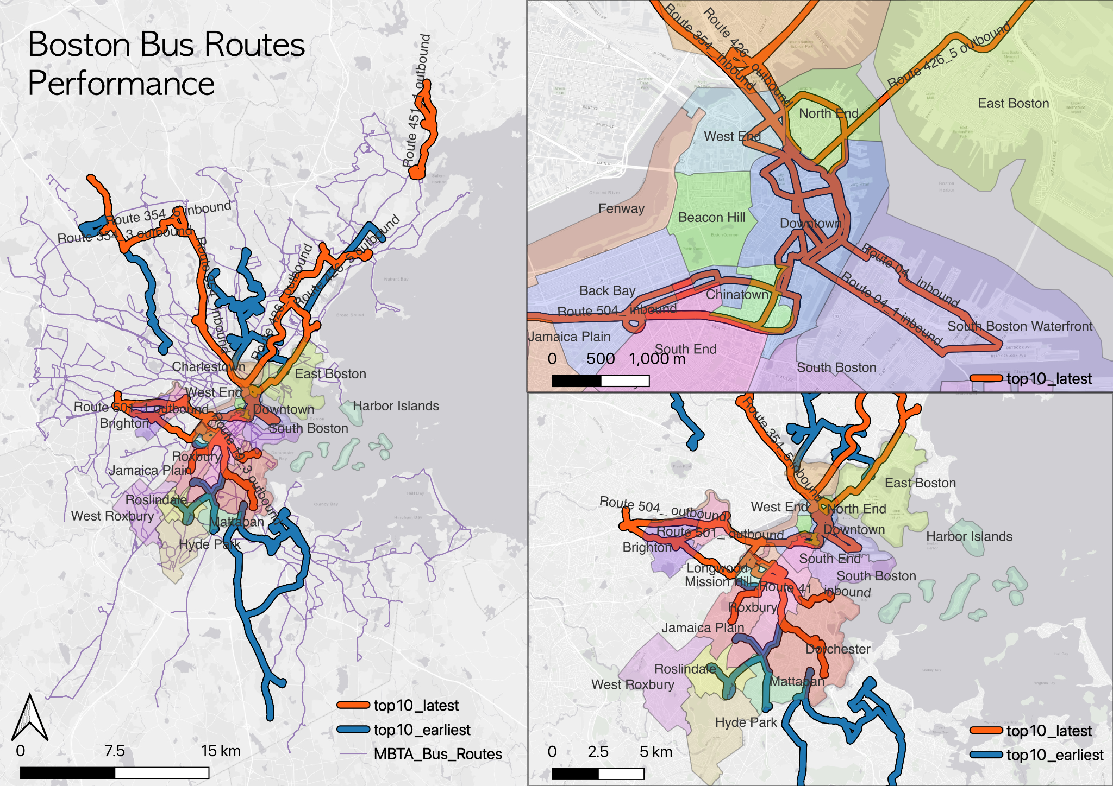
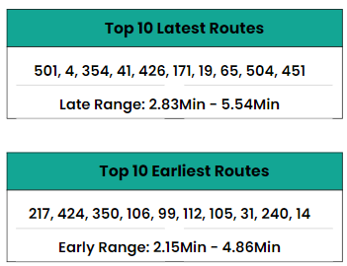
End-to-End Times
Notes:
Future Notes: Ridership and who each line is serving using the entry data/fair tap. Count the really big deviations that stand out rather than looking at the normalized data across such a large timeline like a year.
Potentially connect with someone from MBTA to provide better metrics and methodology for these questions. Hope will get back on how might be interested, such as the IOC boston presentation people or MBTA data analysis team. MBTA better bus project that was done a few months ago. Transit matters advocacy group would also be interested if MBTA won’t be available– not positive that they still work with bus routes.

Slide 11
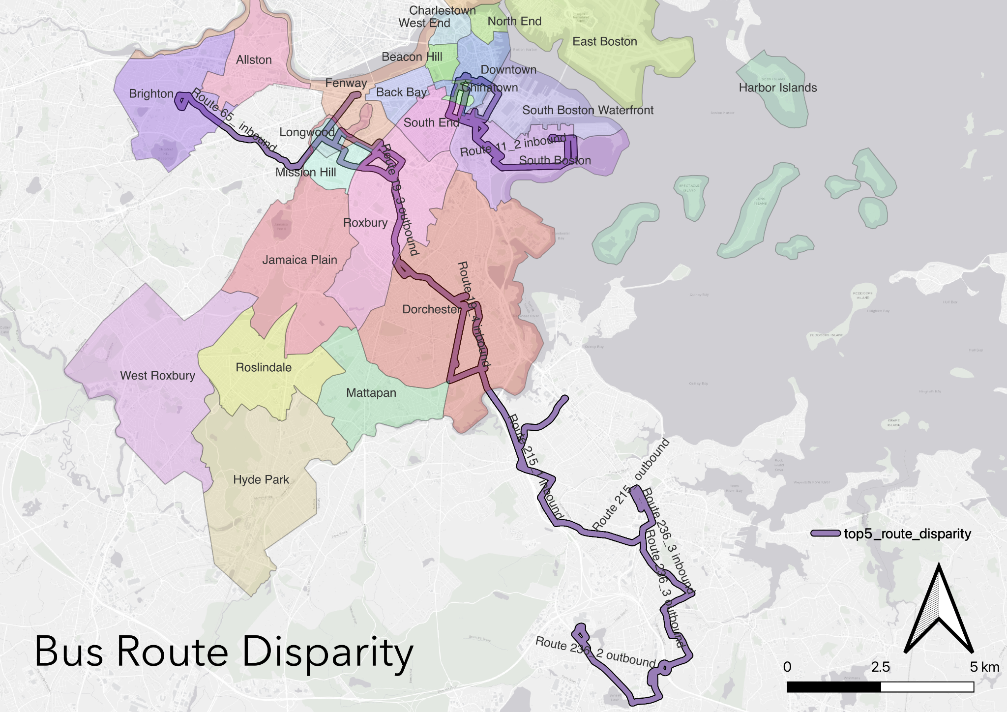
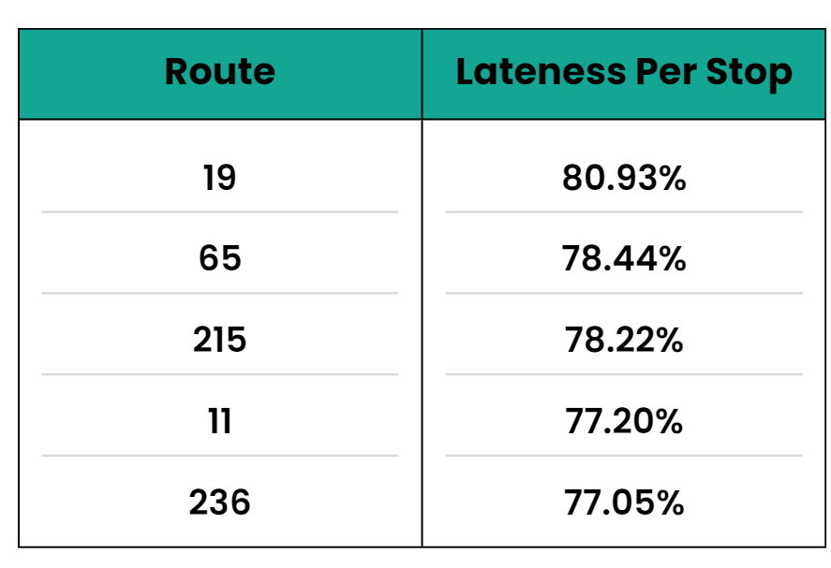
Disparities/Lateness
*One Minute Buffer*
Notes:
Broken down throughout the hours of the day to see if it is consistently running late or just during rush hour. If super populated areas with begin congestion/ stay congested. Seeing how ridership will impact delays. (One of these may be the fair free line).
Use the ridership data to find traffic congestion and how it is affecting bus delays.

Slide 12
q&a

Slide 13
Thank you
Questions?

